Slide 1
Autonomous Cars and Computer Vision

Slide 2
Who Am I
Nico Lindsey
Embrace Pet Insurance
Udacity Course
NicoLindsey@gmail.com

Slide 3
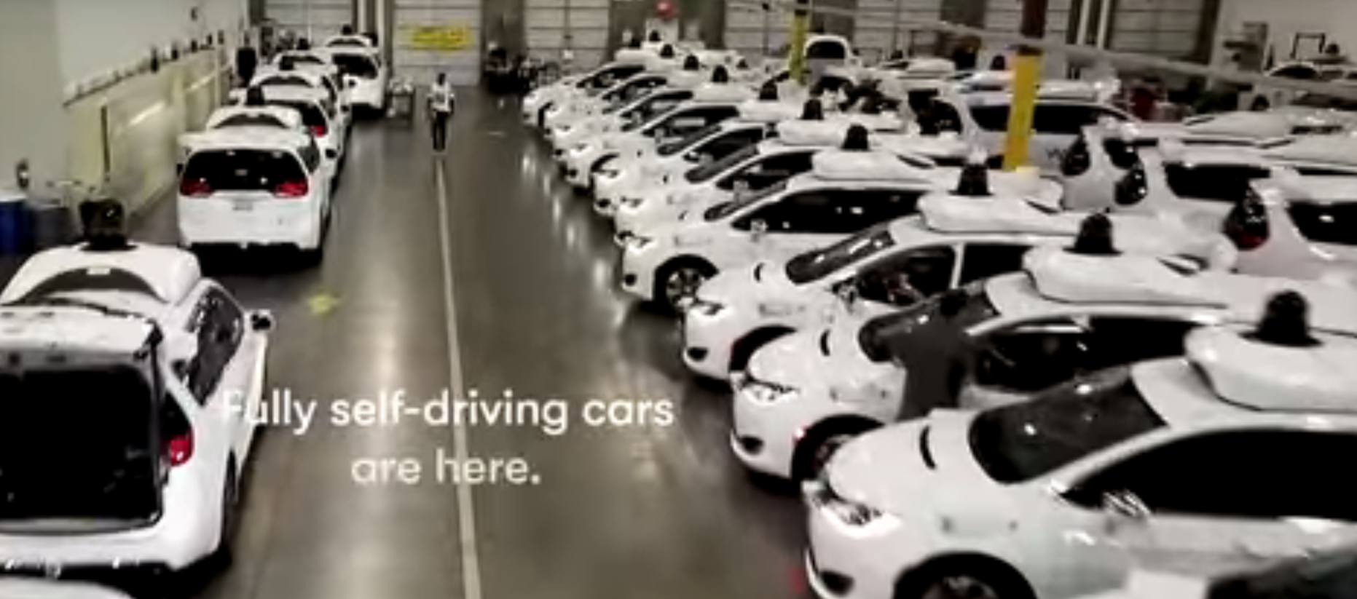
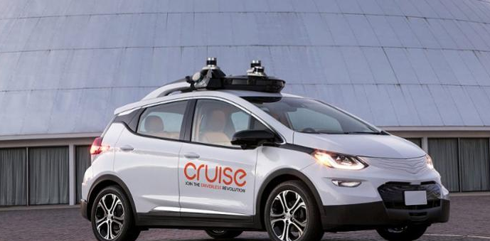
Levels & Timeline
Level 0: No assistance
Level 1: Hands On
Level 2: Hands Off, eyes on
Level 3: Hands off, eyes off
Level 4: Mind off
Level 5: Full
Model Year 2023

Slide 4
Hardware
 | Distance (meters) | Weather | Cost
Camera | 250-500 | Sensitive | $100
Camera | 250-500 | Sensitive | $100
Ultrasonic | 1-2 | No effect | $15
Radar | 30-200 | No effect | $50-150
GPS |  | Sensitive | $80
Lidar | 200 | Cuts Distance | $8,000
Computer | 250-500 | Sensitive | $500 - $15,000 ???
Notes:
Add Chart

Slide 5
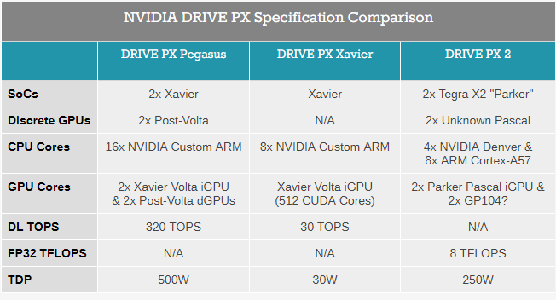
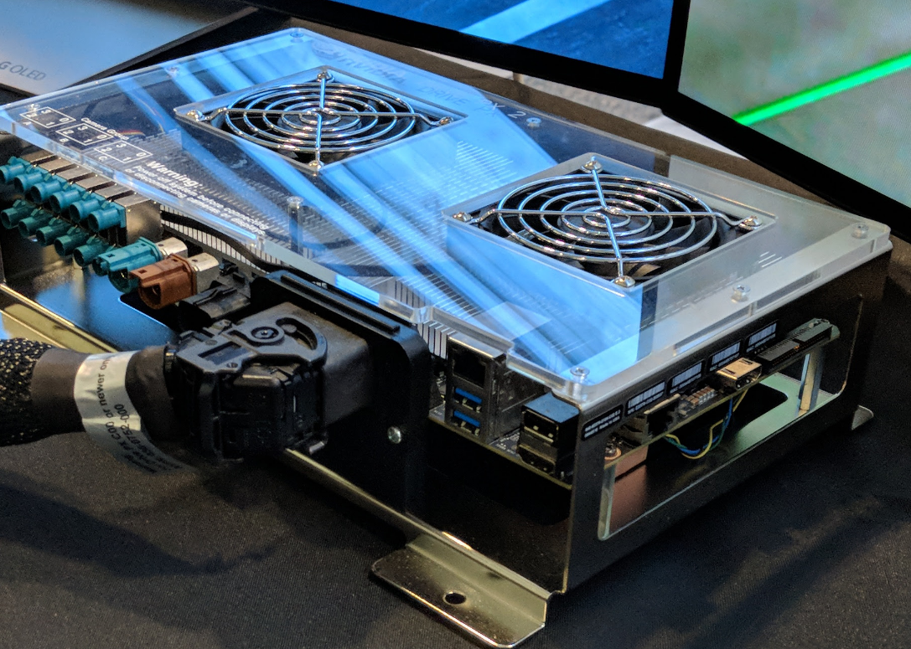
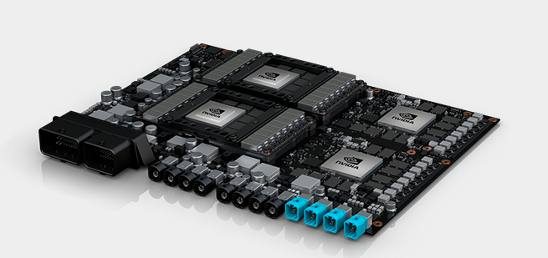
Computer

Slide 6
Computer Vision In Self Driving Cars
Lane Detection
Vehicle Identification
Traffic Sign Classification
Behavioral Cloning

Slide 7
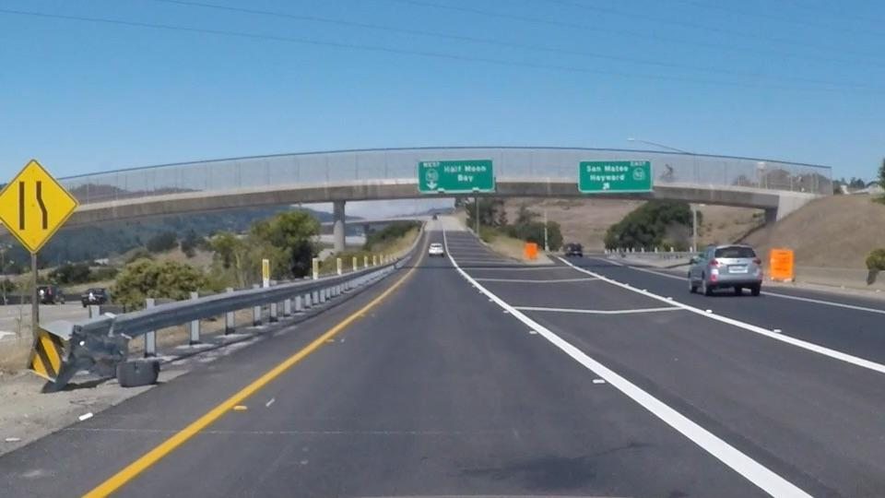
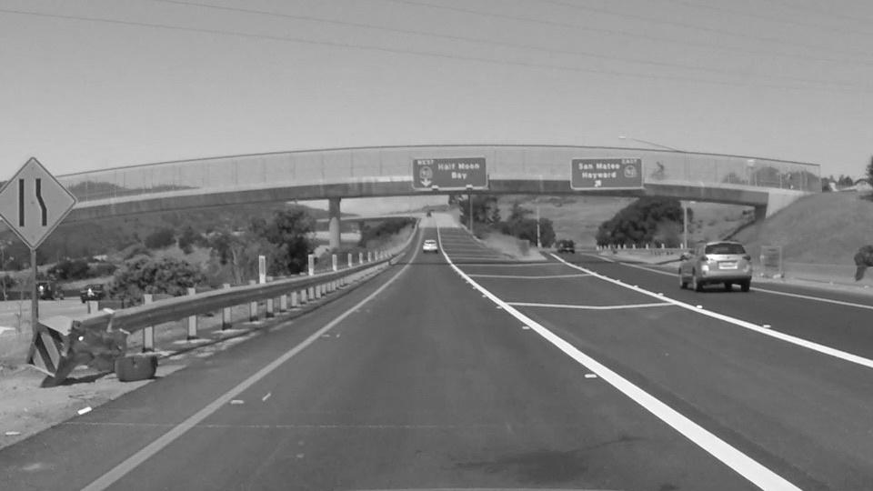
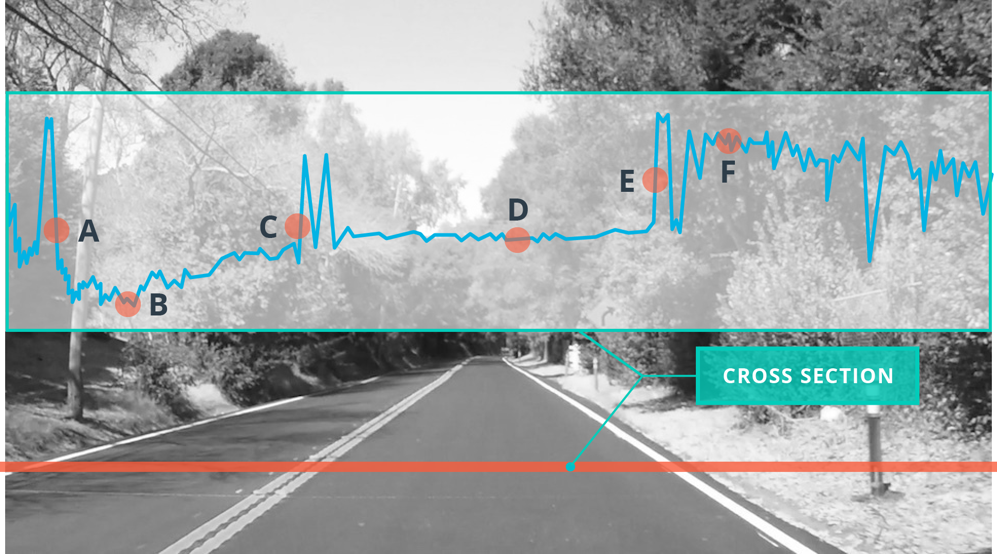
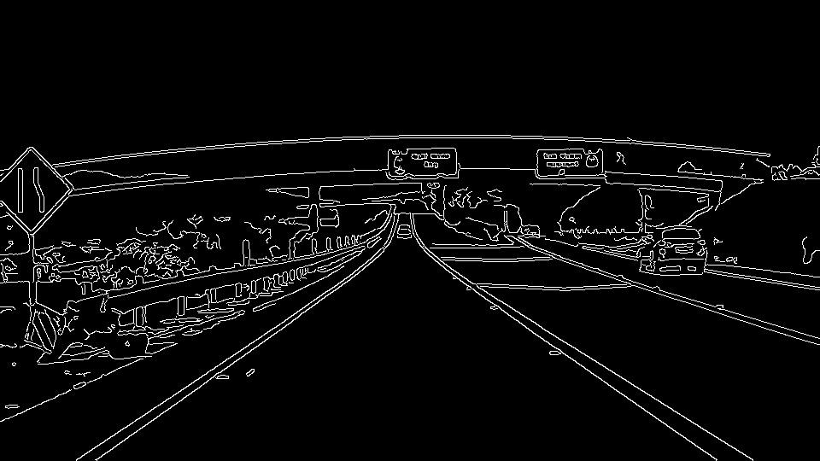
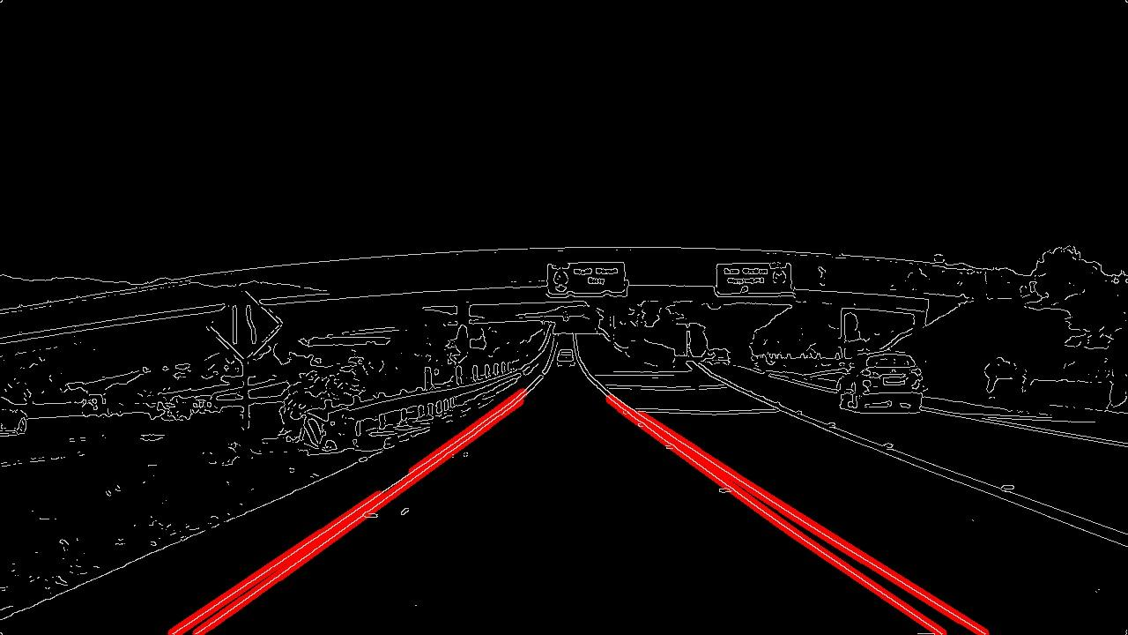
Computer Vision Lane detection
Gray scale
Masking
Canny Edge detection
Hough Transform
Notes:
Camera is mounted same place
Gray, Canny edge detection, Mask, Hough
Select

Slide 9
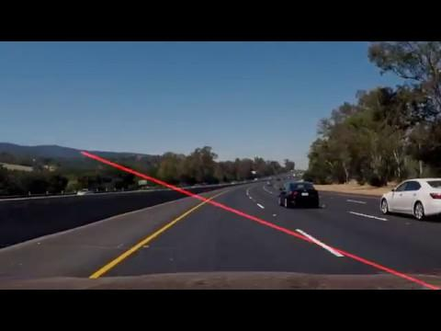

Slide 10
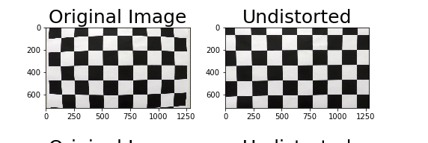
Distortion

Slide 11
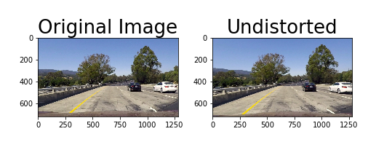
Distortion

Slide 12
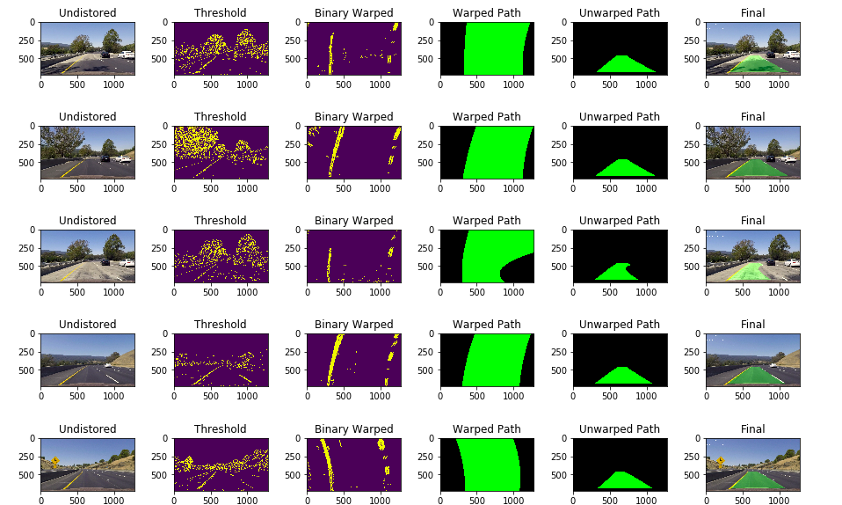
Better Lane Detection

Slide 13
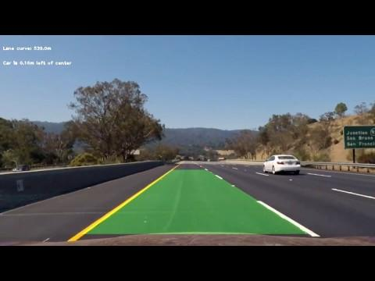

Slide 15
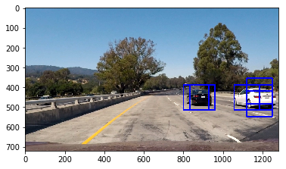
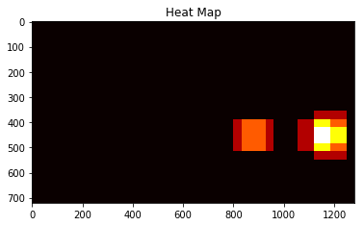
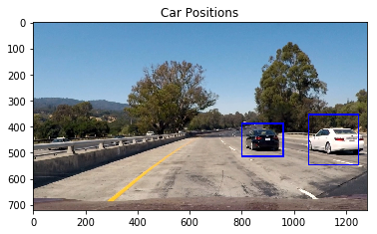
Vehicle Detection

Slide 16
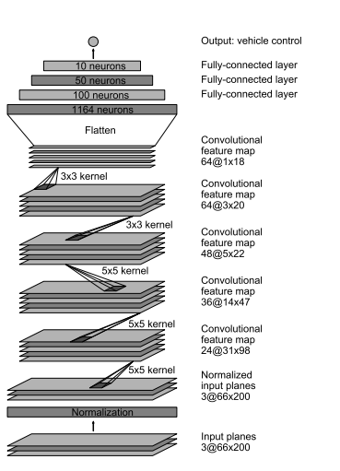
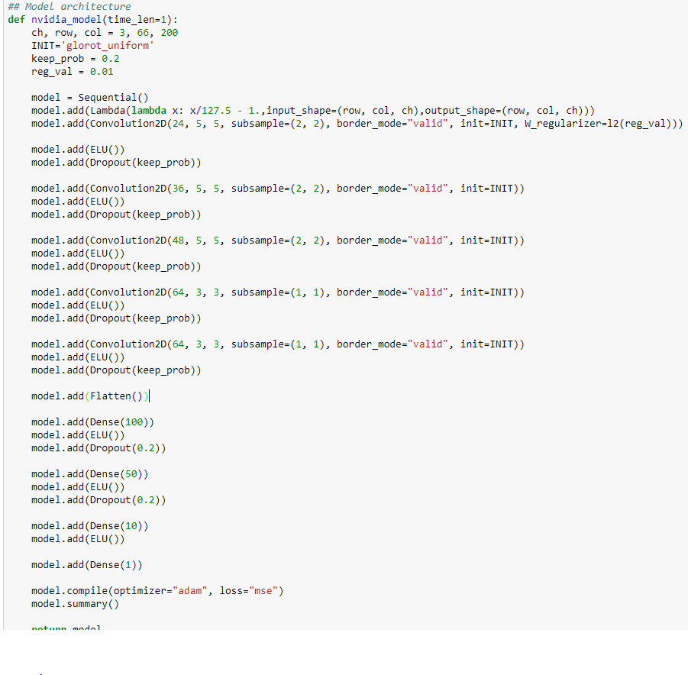
Behavioral Cloning

Slide 17
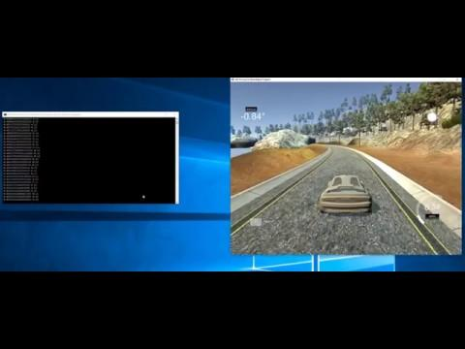
Behavioral Cloning- Simulator

Slide 18
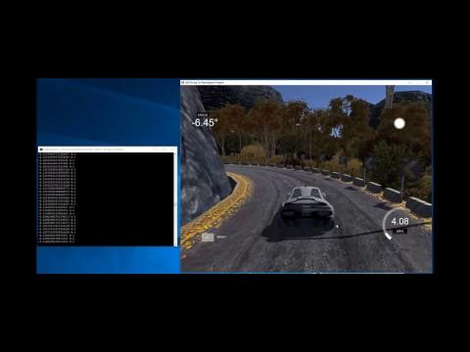
Behavioral Cloning

Slide 19
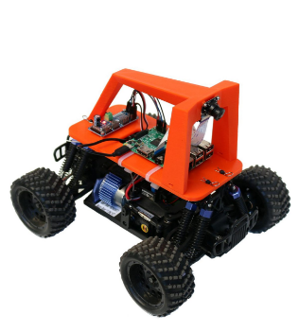
Wrap Up
New Meetup? DIY Robocars Meetup.
Contact me if interested.
nicolindsey@gmail.com
Questions??

